Slide 1
Cheryl Freier
Storybook writer & novelist
Website: www/thegraylinghiddentruthpoems.com
Email: cfreier2003@yahoo.com
Telephone number: (413) 727 8237
Re: If you have an idea for a storybook: we can work on it together. Reasonable fees.

Slide 2
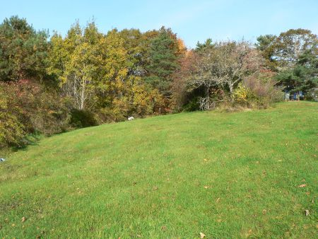
Featuring Cheryl Freier as a writer of historical novels on the Holocaust.
An excerpt of what Cheryl wrote about her book: “As a writer, I chose to have the usage of the fantastic character, the angels to enhance the story and its basic theme. It is Cheryl’s belief that angels during WWII helped to guide people and to save them from the barbaric Nazis.

Slide 3
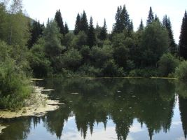
Featuring the second novel that was written and published: The Wild Grasses: Hidden Truth Poems
“…….Joseph said to Martin:, “Rest for a bit……And then we can trek home with the goat, and go quickly in the snow. We will have to take the chance in the open during the day while the snow is not that deep…..If the cold takes hold during the night, and thd snow ices up, we have a bigger problem to deal with.” (page 27)

Slide 4
Cheryl Freier wishes to tell more about the story: The Wild Grasses
…..Then he determined that it was one person and that it was a man coming. He was coming on a motorcycle and he was coming quickly. Theere was only one thing that Sam could think of, “Warn the others!” Sam quickly went to each of them and spoke softly to each of them. “Rider on a motorcycle coming in quickly----not good.” (page 43)

Slide 5
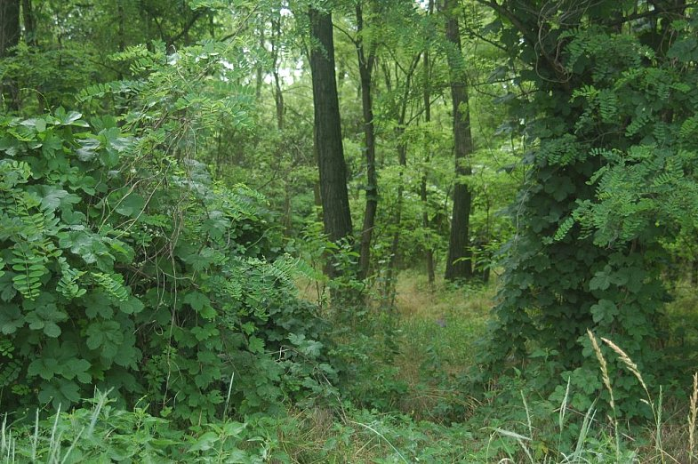
The book talks of hard times; the times of being caught in the throes of a war.
Joseph Freier had saved his wife, Anna, and his four sons: Sam, Bernard, Martin, and Henry, and his daughter, Edith; he had taken them to escape in the woods near Micholovce, Slovakia. They found food in the streams of the waters; They found in the bushes that lined so much of the forest floor, and roots to eat blow the earth; they were surviving.

Slide 6
From the book, The Wild Grasses
Page 11-----Joseph said to Martin, “We must never forget that the Germans could be scouting the woods. They wear white uniforms for camouflage sometimes.” Martin shook his head a few times and replied, “We are certainly not an any ordinary journey.” Joseph interrupted, “Nothing is ordinary until the Germans are completely subdued, and even then it would not be ordinary.”

Slide 7
About The Story: The Freier Family Once Again Eluded The Nazi Captors
Read again one of Cheryl Freier’s books. The Wild Grasses is uniquely crafted into an enriching and unforgettable reading experience. Experience the contrasts of good and bad, visit vicariously the magnificent wilderness and mountain tops and passes. Read about the wilderness of the Slovakian scenery, learn about the devastating destruction of the nearby towns by the ‘monster war machines”……”Feel the emergence of the spirit of good over evil as the family learns of the end of the war.”

Slide 8
Capturing the grayling fish was easy
Pictures of the grayling fish
The grayling fish swims close to the surface of the water
One can scoop out the fish
But it wiggles and fights one until one releases it

Slide 9
Picture of a Grayling Fish. It spawns in the stream waters of Slovakia. It is a well-known fish throughout Europe and is highly prized for its succulent taste and known as beautiful fish.

Slide 10
A Grayling Fish – swimming in shallow waters.

Slide 11
Palatability of the Grayling Fish
The grayling fish was comparable to any special cuisine. It cooked easily. It could be eaten raw. It was a real delicacy.
In major cities and countries in Europe, the fish, the Grayling, is considered a delicacy.

Slide 12
Slovakia is known for its deep wooded areas and mountains. The terrain helped to hide people in WWII.

